Slide 1
Dollar Doodle Project
Course:
Instructor:
Date:
Team Members:

Slide 2
Project Overview
What is Dollar Doodle?
Problem it solves
Target users

Slide 3
Project Goals
Main objectives of the system
Key features users will benefit from

Slide 4
System Concept
How the application works
High‑level workflow of the system

Slide 5
User Interface
Screenshots or mockups
How users interact with the system

Slide 6
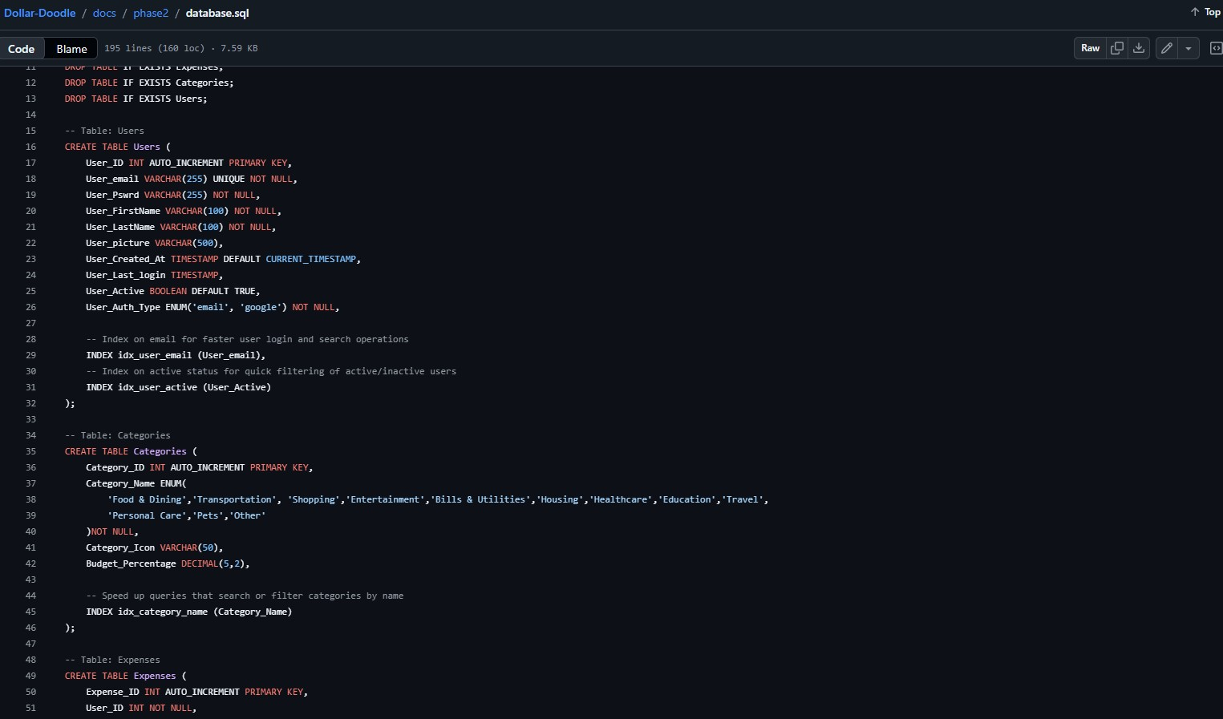
Database Design
Tables used
Key fields
ER diagram or schema

Slide 7
Database Design
Key Fields

Slide 8
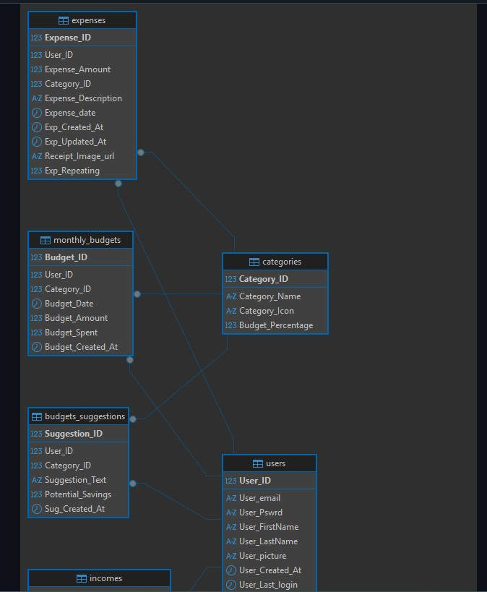
Database Design
ERD Diagram

Slide 9
Backend / Logic
Core processing logic
Important functions or scripts

Slide 10
Data Analysis / Features
Reports or charts generated
Budget or spending insights

Slide 11
Testing & Challenges
Issues encountered
How the team solved them

Slide 12
Live Demo / Example Use
Show the system working
Example user workflow

Slide 13
Future Improvements
Possible upgrades
New features that could be added

Slide 14
Conclusion
Summary of project
What the team learned
Questions

